Slide 1
Organizing a genomic project workspace
--GDMP--
Ouso Daniel
icipe | H3ABioNet | The Carpentries
@ousodanos

Slide 2
Why organise?
The backbone of any research project - consider a dictionary
Make analysis workflow easy
Easy to recreate
Easy to share
A way to keep a lasting relationship with your work
Saves time & space(resources)
Good for automation
@ousodanos

Slide 3
Research reproducibility
Extent of consistency of results for a repeated experiment - exact or similar (replicability) methodology (Wikipedia)
THE FAIR DATA PRINCIPLE (FDP)
Intent: guide for management and stewardship of data
Target: Producers and publishers
Goal: To support manual and automated deposition, exploration, sharing, and reuse (Wilkinson et al., 2016)
@ousodanos

Slide 4
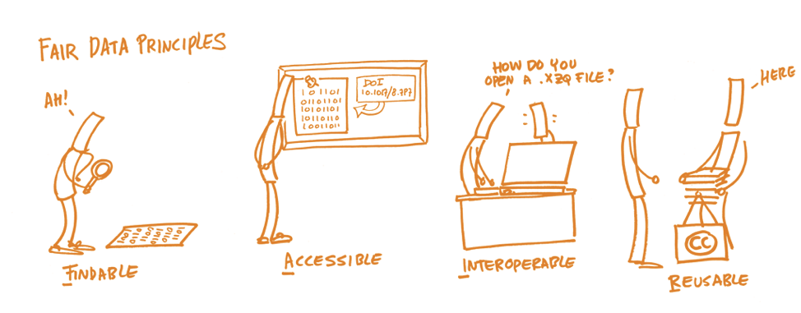
Research reproducibility
openaire.eu
@ousodanos

Slide 5
Research reproducibility
To be Findable:
globally unique and persistent identifier
To be Accessible:
retrievable by their identifier using a standardized communications protocol (Wilkinson et al., 2016)
@ousodanos

Slide 6
Research reproducibility
To be Interoperable:
use a formal, accessible, shared, and broadly applicable language for knowledge representation.
To be Reusable:
richly described with a plurality of accurate and relevant attribute (Wilkinson et al., 2016)
@ousodanos

Slide 7
Data Management
The implementation of policies and procedures in control and use of data.
Components of data management: governance, architecture, modelling/design, DB & storage mgnt, integration & interoperability, security, documentation, quality etc (Wikipedia)
@ousodanos

Slide 8
Organizational components of a sequencing project
Experimental setup and conditions metadata (design)
Measurements of experimental parameters
Sequencing preparation and sample information
Sequences and associated files
Workflow of analysis
@ousodanos

Slide 9
Data Management Plan (DMP)
A DMP helps you to ask all the useful questions regarding DM
Why a DMP?
It just the right thing to do
Funding
FAIRness
Potential DM obstacles
@ousodanos

Slide 10
Data Management Plan (DMP)
Making a DMP
Several templates for a DMP exist depending on the questions one need to address based on their domain of research.
Good news! There are tools to help you come up with a DMP
@ousodanos

Slide 11
Organising your sequencing project
Data Tidiness
Think data before you ship out for sequencing - metadata
Genomics metadata standards
Data in spreadsheets - think computationally:
Let alone raw data
Row - sample/observations
Col - variables
Intuitive no-spacing naming
Cell - one piece of info
Export data in text-format
@ousodanos
Notes:
Metadata key for collaboration
Structured tabular data if foundational for effective analysis

Slide 12
Organising your sequencing project
Planning for NGS projects
Planning, documenting, organising and execution - reproducibility/replicability
Sending out samples for seq - fill in a submission spreadsheet
Retrieving results from from facility
Documentation - metadata
Seq files
Validate your data downloads
@ousodanos

Slide 13
Organising your sequencing project
Data storage
Store and backup your raw data, it is important that it remains unchanged (file permissions) for fallback - two physically diff locations
Minimum - lab head and yourself should have access
Storage - HDDs, Severs, Cloud (upto 5G free at OSF)
@ousodanos

Slide 14
More resources
This content is largely abstracted from Data carpentry - Project Organization and Management for Genomics of The Carpentries
NNLM-DMP
GFBio
Stanford libraries
The purpose of this presentation is knowledge to intro on genomics project skills (TO BE COVERED LATER)
@ousodanos

Slide 15
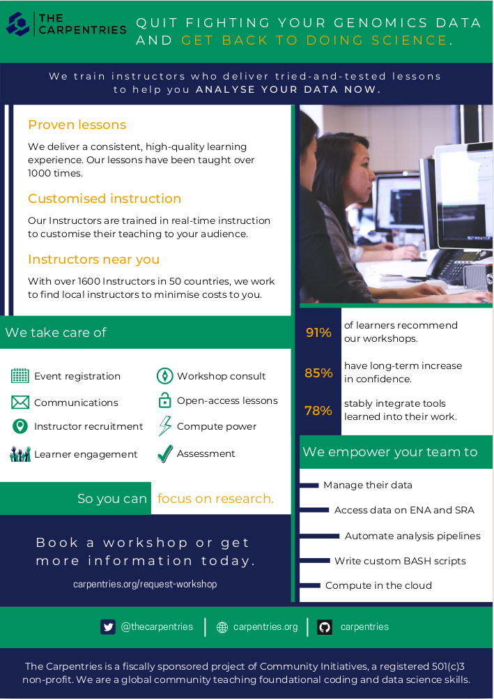
Data Carpentry - Where to learn more!
@ousodanos

